Slide 1
UNIVERSAL VERIFICATION METHODOLOGY(UVM)

Slide 2
Verification Challenges
Finding all bugs early and fast in design life cycle.
Increasing complexity in design.
Limited Time.
Limited Resources.
Always more possible test scenarios to test than available time and resources.

Slide 3
What is the need for Standard Methodology?
Traditional methods doesn’t scale up or enable reuse across verification for complex designs.
Verification is increasingly becoming critical and complex
There is a need to speedup overall process and increase efficiency from project to project.
What is a Verification Methodology?
Defines a set of standards or process that enables efficient verification.
It addresses automation, abstraction and reuse.

Slide 4
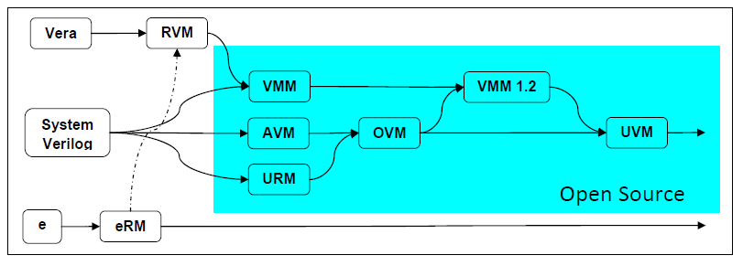
History of Verification Methodologies

Slide 5
What is UVM?
UVM stands for Universal Verification Methodology.
UVM is based on the previous methodology OVM 2.1.1
It is a hybrid of technologies that originated in Mentor’s AVM, Mentor & Cadence OVM, Verisity’s eRM, and Synopsys VMM- RAL.
It is adopted as IEEE standard 1800.2 in November, 2017.

Slide 6
Highlights of UVM
Constrained random, coverage driven verification
Configurable and flexible testbenches
Transaction Level Communication
Standardized Messaging
Library which consists of predefined classes
Predefined macros
Register layer
Separation of sequence from the Testbench

Slide 7
UVM class library
The UVM library provides all the building blocks that we require to build modular, scalable, reusable, verification environments.
This library contains base classes, utilities and macros to support the entire verification process.
In order to use UVM Library, user needs to:
Compile uvm_pkg.sv file.
Import uvm_pkg into the desired scope.
Include file that contains uvm macros.

Slide 8
A simple Hello World Program using UVM
`include “uvm_pkg.sv”
//include for compiling if not available by default
module hello_world;
import uvm_pkg :: *;
//importing definitions inside uvm_pkg
`include “uvm_macros.svh”
//including uvm macros
initial
`uvm_info(“info1”, “Hello World”, UVM_LOW);
endmodule

Slide 9
UVM Testbench Basics
The testbench is divided into static and dynamic components
Static Components
forms the testbench hierarchy
remains throughout simulation
Example: Driver, Checker, Monitor, Scoreboard
Dynamic components
forms the stimulus.
are generated dynamically
Example: Transactions, Sequences.

Slide 10
Simplified UVM Inheritance Diagram
Notes:
uvm_void=> uvm_object
uvm_object:
copy(),clone(),print()...
uvm_sequence_item:
Provides the hooks for sequencer and sequence , So you can generate transaction by using sequence and sequencer, and uvm_transaction provide only basic methods like do_print and do_record etc
uvm_report_object:
uvm_report_*()
uvm_component:
get/set_config() create() get_full_name()
build_phase()/connect_phase()/run_phase()

Slide 11
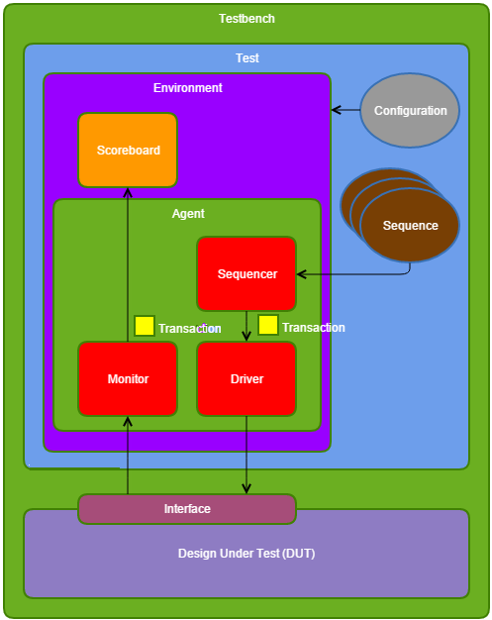
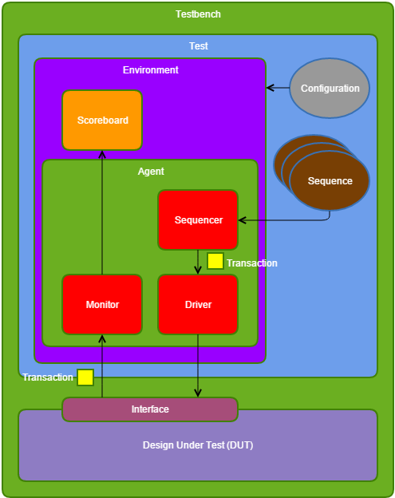

Slide 12
Available UVM Components (all are extended from base class uvm_component)
uvm_driver
uvm_sequencer
uvm_subscriber
uvm_env
uvm_test
uvm_monitor
uvm_scoreboard
uvm_agent
Available UVM Classes to model sequences and transaction items
uvm_sequence
uvm_sequence_item
uvm_transaction

Slide 13
Transaction Level Modelling
Transaction – A class object that includes necessary information needed for communication b/w two components.
Writing a transaction class in UVM methodology.
class simple_trans extends uvm_transaction;
rand bit [31:0] data;
rand bit [31:0] addr;
……
…..
endclass
But, the suggested method of writing transaction is by extending the class uvm_sequence_item.
Becz, it supports additional methods which are helpful
class simple_trans extends uvm_sequence_item;
rand bit [31:0] data;
rand bit [31:0] addr;
……
…..
endclass

Slide 14
Transaction Level Modelling
It is an approach that consist of multiple process communicating with each other by sending transactions back and forth through channels.
It is the basis for modularity and re use in UVM
It is all about communication through the method calls
TLM port specifies the API to be used
TLM export supplies the implementation of the methods
Connections are between the ports and exports not the components
Transactions are objects
Ports and exports are parameterized by the Transaction type being communicated
Notes:
(Application Programming Interface) API is the acronym for Application Programming Interface, which is a software intermediary that allows two applications to talk to each other.

Slide 15
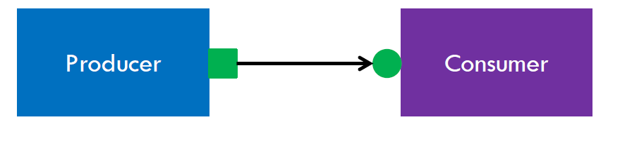
Connection b/w the Producer and Consumer through TLM Port and Export
EXPORT
Methods supported by TLM interface
Blocking Methods
put
get/peek
Non-blocking Methods
try_put
try_get/try_peek
write
PORT
Notes:
Use API (get or put) based on the requirement. (Ex.) If I want to transfer data from Producer to Consumer using put method means “From where I have to put the transaction?- from Producer”. The port must have the API and Export must have the Implementation of the method.
Try_get() => if(try_get())
Function Return Value
0 – Fail because Target is busy
1 – Successful

Slide 16
Producer/Consumer example – put
At Producer:
class producer extends uvm_component;
uvm_blocking_put_port #(simple_trans) put_port;
function new(string name=“producer”, uvm_component parent);
put_port = new(“put_port”, this);
endfunction
Virtual task run();
simple_trans t;
// generate t;
put_port.put(t);
endtask
endclass
At consumer:
class consumer extends uvm_component;
uvm_blocking_put_imp #(simple_trans, consumer) put_export;
function new(string name=“consumer”, uvm_component parent);
put_export = new(“put_export”, this);
endfunction
task put(simple_trans t);
// operation performed on t
endtask
endclass
Notes:
uvm_put_port, uvm_get_port

Slide 17
Producer/Consumer example – get
At Producer:
class producer extends uvm_component;
uvm_blocking_get_imp #(simple_trans,producer) get_export;
function new(string name=“producer”, uvm_component parent);
get_export = new(“get_export”, this);
endfunction
task get(output simple_trans t);
//
//
endtask
endclass
At consumer:
class consumer extends uvm_component;
uvm_blocking_get_port #(simple_trans) get_port;
function new(string name=“consumer”, uvm_component parent);
get_port = new(“get_port”, this);
endfunction
virtual task run();
simple_trans t;
get_port.get(t);
…..
endtask
endclass
Universal verification Methodology

Slide 18
Connecting TLM ports
Agent
class agent extends uvm_component;
producer prod;
consumer cons;
virtual function void build();
//build the producer and consumer component
endfunction
virtual function void connect();
//for put
prod.put_port.connect(cons.put_export);
//for get
cons.get_port.connect(prod.get_export);
endfunction
endclass
Notes:
Driver have: seq_item_port and Sequencer have: seq_item_export by default in agent we have connect it using .connect method

Slide 19
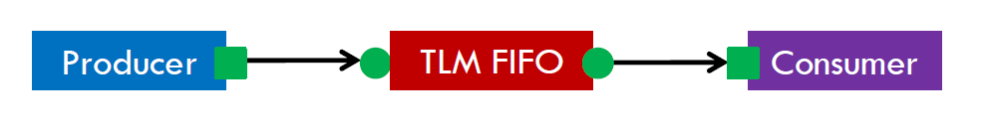
TLM fifo
If the components need to communicate multiple transactions
If the receiving side is still processing some transaction you wouldn’t want to block the sending set.
The predefined class for TLM fifo is uvm_tlm_fifo
It contains implementations all the TLM methods such as put, get, peek etc.,

Slide 20
How to implement the TLM fifo?
class agent extends uvm_component;
uvm_tlm_fifo #(simple_trans) tlm_fifo;
producer prod;
consumer cons;
virtual function void build ();
prod = new(“prod”,this);
cons = new(“cons”,this);
tlm_fifo = new(“tlm_fifo”,this, 25);
endfunction
virtual function void connect();
prod.put_port.connect(tlm_fifo.put_export);
cons.get_port.connect(tlm_fifo.get_export);
endfunction
endclass
Depth of the fifo

Slide 21
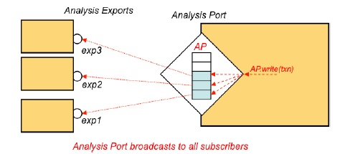
Analysis TLM Port & Export
One component to many component
It is usually used by collectors and scoreboard
Analysis port contains list of all the analysis exports that are connected to it
It supports the write method
Whenever the component calls the analysis_port.write(), it cycles through all the list and calls the write method in each of the connected exports

Slide 22
How to implement the TLM Analysis port and export?
class monitor extends uvm_component;
uvm_analysis_port #(packet) analysis_port;
function new (string name, uvm_component parent);
super.new(name, parent);
analysis_port=new(“analysis_port”, this);
endfunction
virtual task run ();
packet p=new;
…….//collect packet from lower level
analysis_port.write(p); //write collected transaction
endtask
endclass
class scoreboard extends uvm_component;
uvm_anaysis_imp #(packet, scoreboard) analysis_export;
function new (string name, uvm_component parent); super.new(name, parent); analysis_export=new(“analysis_export”, this);
endfunction
function void write (packet p);
//perform some check on packet p
endfunction
endclass
In Environment connect phase:
agnt.mon.analysis_port.connect(sb.analysis_export);
Notes:
* In environment we have connect the port and export: agnt.mon.pport.connect(sb.eport);

Slide 23
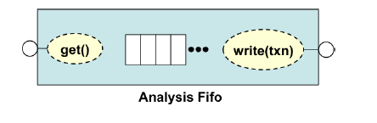
Analysis FIFO
Sometimes transactions that are passed through analysis port cannot be processed immediately.
In such case the transaction needs to stored before they are consumed.
uvm_tlm_analysis_fifo is used to address this requirement. It has an analysis_export that can be directly connected to analysis ports.
Analysis fifo has unbound size so that write always succeed.
Notes:
Connection types:
Port to export
Port to port
Export to export

Slide 24
UVM Factory
uvm_factory (UVM Factory) is a class which is used to create UVM objects and components during runtime
To enable an object of one type to be substituted with an object of a derived type without changing the testbench structure or even the testbench code
User defined objects and components can be registered with the factory via typedef or macros invocation
Using the factory involves three basic operations
Registering objects and components types with the factory
Using factory to create objects or components
Configuring the factory with type and instance overrides
Class scoreboard extends uvm_component;
typedef uvm_component_registry #(scoreboard,"scoreboard") type_id;
Notes:
Class scoreboard extends uvm_component;
typedef uvm_component_registry #(scoreboard,"scoreboard") type_id;
static function type_id get_type();
return type_id::get();
endfunction

Slide 25
How to register the components with the factory?
Using the macro method
Non-Parameterized Objects:
class packet extends uvm_object;
`uvm_object_utils(packet)
endclass
Parameterized Objects:
class packet #(type T=int, int Width=32) extends uvm_object;
`uvm_object_param_utils(packet #(T, Width))
endclass
Non-Parameterized Components:
class comp extends uvm_component;
`uvm_component_utils(comp)
endclass
Parameterized Components:
class comp #(type T=int, int Width=32) extends
uvm_component;
`uvm_component_param_utils(comp #(T, Width))
endclass
Notes:
uvm_component_registry #( type T = uvm_component , string Tname = "" ) extends uvm_object_wrapper

Slide 26
How to create the objects of classes registered in factory?
Using the function create
Syntax to create objects: handle = class_name::type_id::create(“handle”);
Syntax to create components : handle = class_name::type_id::create(“handle”, this);
class simple_trans extends uvm_sequence_items;
`uvm_object_utils(simple_trans)
rand bit [31:0] data;
rand bit [31:0] addr;
endclass
class sequence extends uvm_sequence;
`uvm_object_utils(sequence)
simple_trans trans;
virtual function void build_phase();
trans = simple_trans::type_id::create(“trans”);
endfunction
endclass

Slide 27
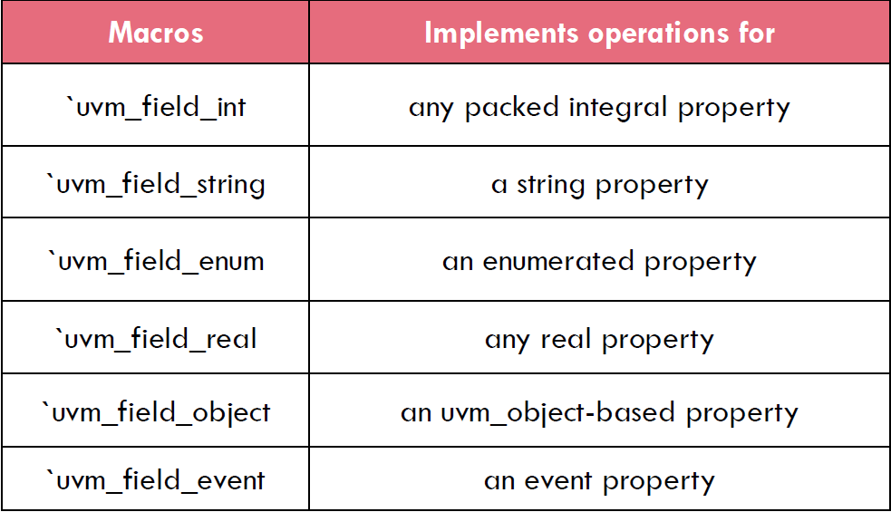
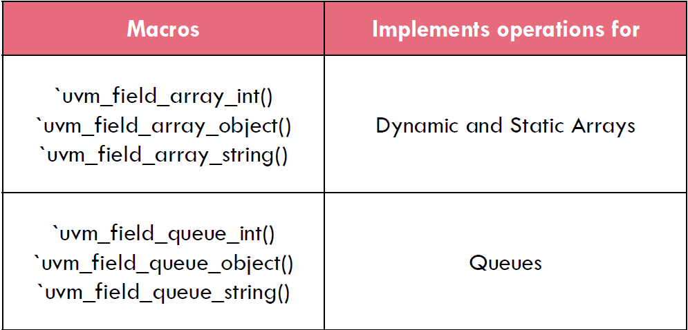
UVM Field Macros
`uvm_field macro includes the given field in implementation of print(), copy(), clone(), pack(), unpack(), compare() and record() methods for an object
syntax : `uvm_field_* (field_name, flags)

Slide 28
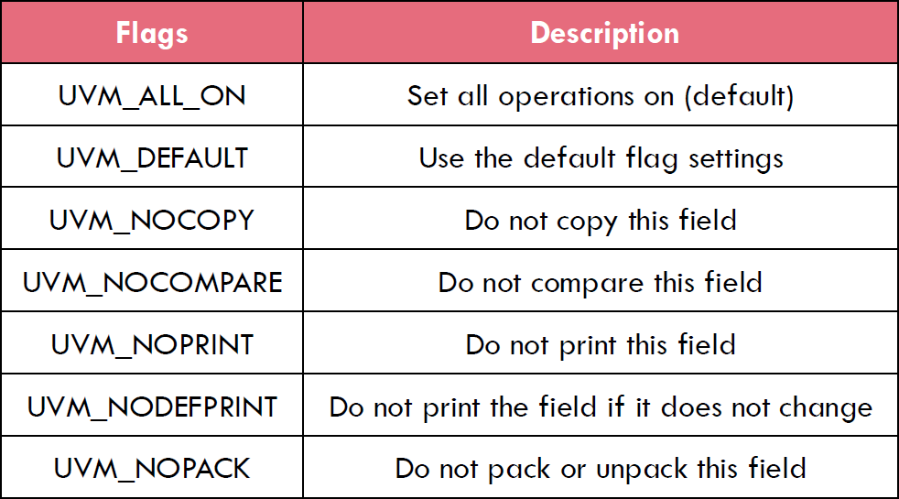
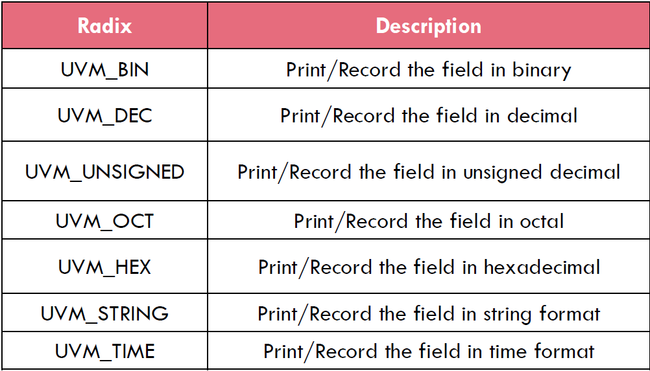
Field Arguments
Notes:
`uvm_field_int(field, UVM_DEC) //use decimal radix
UVM_HEX is the default radix

Slide 29
Usage of field macros
class simple_trans extends uvm_sequence_item;
rand bit [31:0] addr;
rand bit [31:0] data;
`uvm_object_utils_begin(simple_trans)
`uvm_field_int(addr, UVM_ALL_ON)
`uvm_filed_int(data, UVM_ALL_ON)
`uvm_object_utils_end
endclass
Methods supported:
compare
copy
pack
unpack
print
record

Slide 30
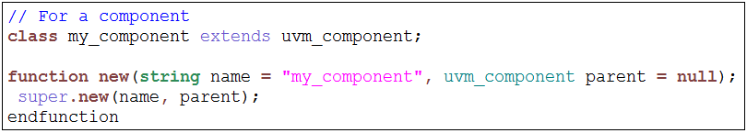
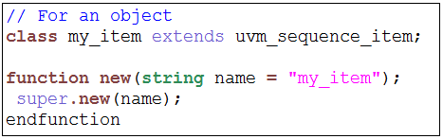
Constructor Defaults
The uvm_component and uvm_object constructors are virtual methods
The defaults are different for components and objects
For a component:
For an object:
Notes:
In uvm 1.2 version it is mandatory to specify the function new(arguments) and inside that we have to call super.new()
________________________________________________________________________________________________
// Function: new //
* Creates a new component with the given leaf instance ~name~ and handle to to its ~parent~. If the component is a top-level component (i.e. it is
created in a static module or interface), ~parent~ should be null.
* The component will be inserted as a child of the ~parent~ object, if any. If ~parent~ already has a child by the given ~name~, an error is produced.
* If ~parent~ is null, then the component will become a child of the implicit top-level component, ~uvm_top~.
* All classes derived from uvm_component must call super.new(name,parent). extern function new (string name, uvm_component parent);
_________________________________________________________________________________________________
* Use of function new():
//- When we create a monitor using create method we are passing 2 arguments (“name”,this)
- Automatically function new will be called, we should mention super.new(name,parent) it will call the new method available in uvm_compoment (There it will call it’s super new-#) So it will use to build a hierarchy structure. Incase the created component wants to be a top level we have to pass ‘null’ insteand of ‘this’
- While create a component(static throughout the simulation) we have to pass both argument name and child class handle. For transient objects it is not needed because they are dynamic in nature
#-> In function new() of uvm_component and it’s parent uvm_report_object they implement some logics
___________________________________________________________________________________________

Slide 31
Overriding Types
Type Overriding:
Every time a component class type is created in the Testbench hierarchy, a substitute type i.e. derived class of the original component class, is created in its place. It applies to all the instances of that component type.
<original_type>::type_id::set_type_override(<substitute_type>::get_type(), replace);
Instance Overriding:
It substitutes ONLY a particular instance of the component OR a set of instances with the intended component. The instance to be substituted is specified using the UVM component hierarchy.
<original_type>::type_id::set_inst_override(<substitute_type>::get_type(), <path_string>);
“path_string” is the hierarchical path of the component instance to be replaced.
Notes:
Default: bit replace=1 in set_type_override
Using registry wrapper methods:
original_type::type_id::set_type_override(override_type);
original_type::type_id::set_inst_override(override_type,...);
Using component factory methods:
set_type_override_by_type(original_type,override_type);
set_inst_override_by_type(...,original_type,override_type);

Slide 32
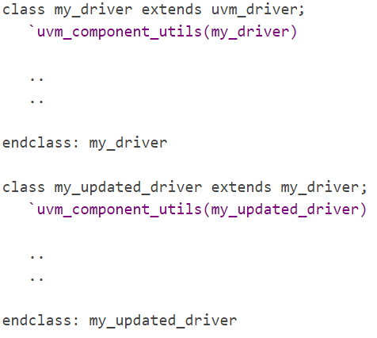
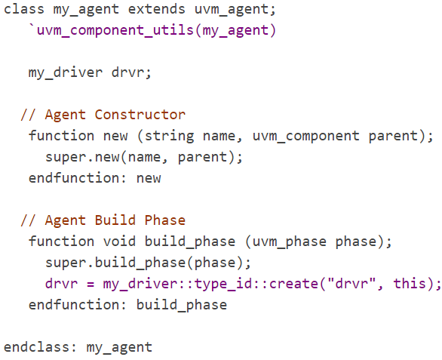
Type Overriding:
Notes:
phase argument is mainly used for objections

Slide 33
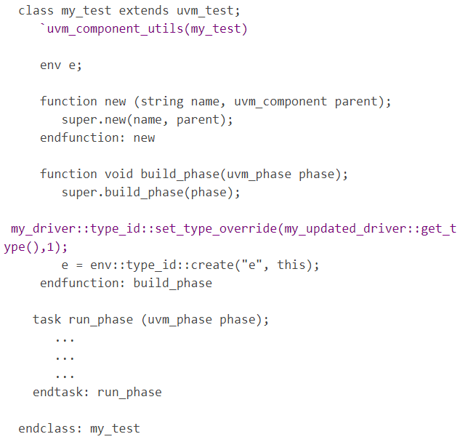
Type Overriding:
Note:
set_type_override() to be placed before the create() command inside the build_phase() of the my_test class

Slide 34
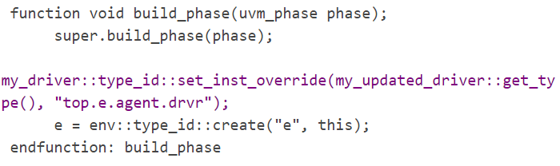
Instance Overriding:
Note:
Objects or sequence related objects are generally only used with type overrides since the instance override approach relates to a position in the UVM Testbench component hierarchy which objects do not take part in.

Slide 35
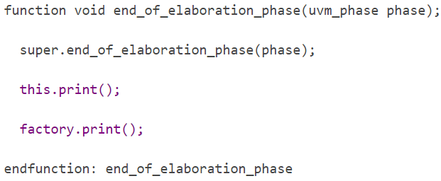
Debugging the UVM Testbench Structure & Factory Content:
Print out the structure of the testbench in tabular form and to query the types that were registered with the Factory, call the methods,
this.print()
factory.print()
Notes:
this.print display the test structure printout - test.factory display the types registered in the factory for test
(Ex.)
class axi_test extends uvm_test;
uvm_factory factory;
uvm_coreservice_t cs = uvm_coreservice_t::get();
function void end_of_elaboration_phase(uvm_phase phase);
super.end_of_elaboration_phase(phase);
this.print();
factory = cs.get_factory();
factory.print();
endfunction

Slide 36
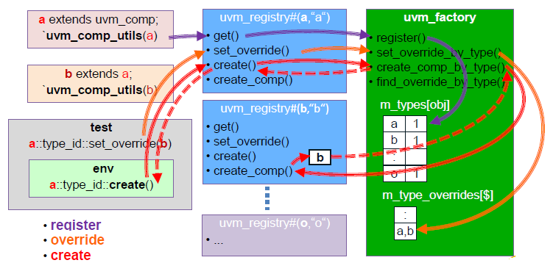
Factory Operation

Slide 37
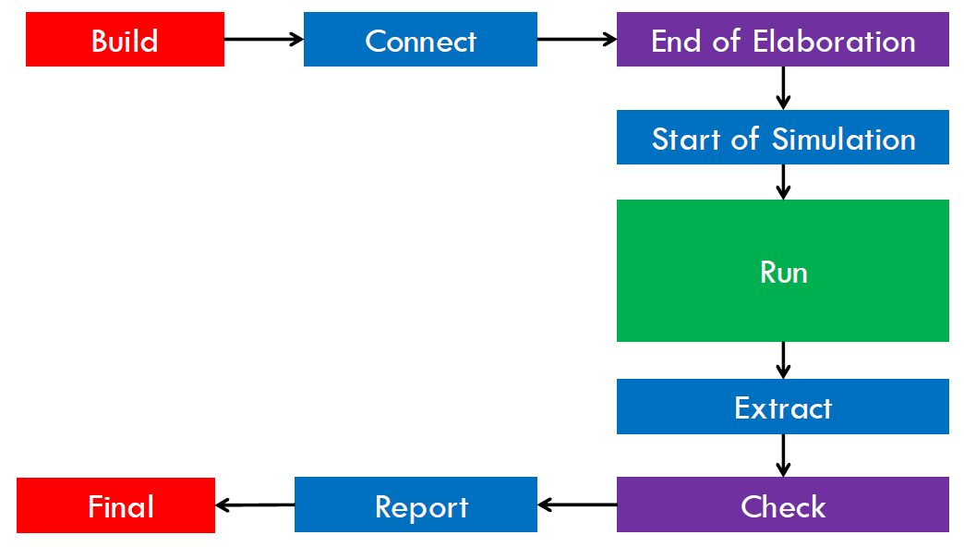
UVM Phases
In Verilog and VHDL, static elaboration of instances occur before simulation starts
In System Verilog classes are instantiated at run-time
Then what is the good time to start data generation and transfer, assuming all UVC components have been created and connected properly
UVM Provides concept of Phases to solve this issue. Each phase has a defined order of execution

Slide 38
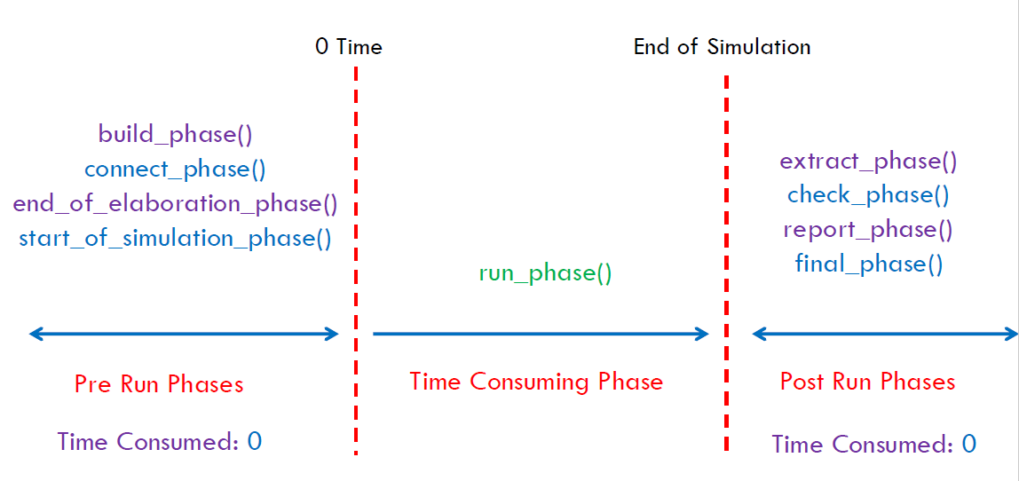
Execution of UVM Phases

Slide 39
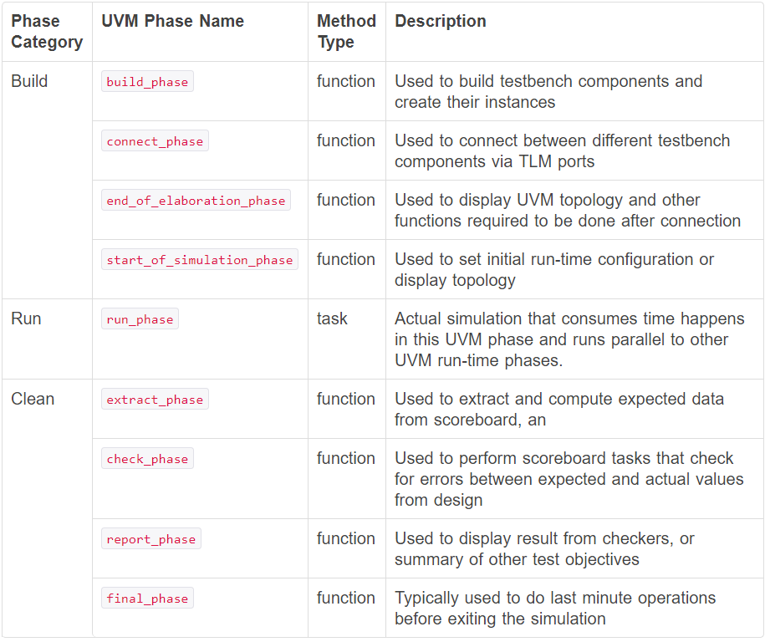
UVM Phases description
Notes:
uvm_phase => uvm_bottomup_phase => all phases except run_phase and build_phase
uvm_phase => uvm_topdown_phase => uvm_build_phase
uvm_phase => uvm_task_phase => uvm_run_phase

Slide 40
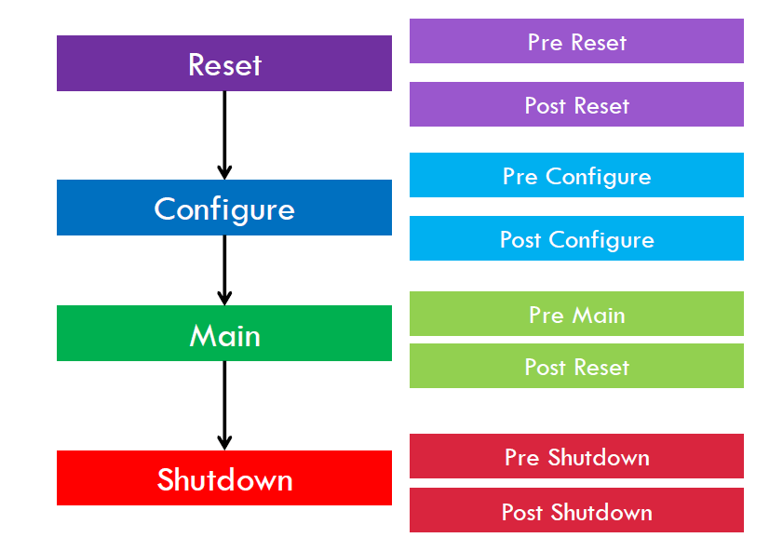
Sub run phases
Notes:
The phase ends if the timeout expires before all objections are dropped. By default, the timeout is set to 9200 seconds. You may override this via uvm_root::set_timeout.
__________________________________________________
function void set_timeout(time timeout, bit overridable = 1)
__________________________________________________
function void start_of_simulation_phase(uvm_phase phase);
super.start_of_simulation_phase(phase); // uvm_top is a constant handle of uvm_root declared in uvm_root.svh file
uvm_top.set_timeout(100s, 1); // Override default timeout to 100 second
endfunction : start_of_simulation_phase
__________________________________________________
cmd line : +UVM_TIMEOUT=<value>

Slide 41
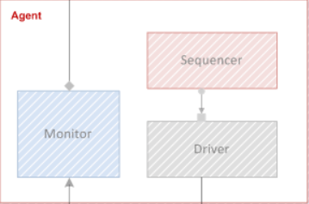
How to write the UVM phases?
class agent extends uvm_component;
`uvm_component_utils(agent)
sequencer sqr;
driver drv;
monitor mon;
function new(string name=“agent”, uvm_component parent);
super.new(name,parent);
endfunction
virtual function void build_phase(uvm_phase phase);
sqr = sequencer::type_id::create(“sqr”, this);
drv = driver ::type_id::create(“drv”, this);
mon = monitor ::type_id::create(“mon”, this);
endfunction
endclass

Slide 42
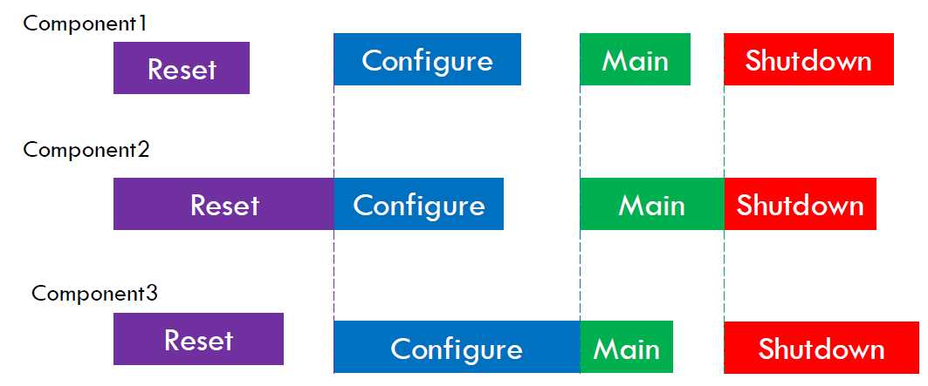
Phase Synchronization

Slide 43
Objections
Components can raise and drop objections
A component that raises objection remains in same phase till all the objections are dropped
Raising and dropping of objection is done in run phases
Usage:
phase.raise_objection(this); //to raise objection in this object
phase.drop_objection(this); //to drop objection in this object
String displayed
Use +UVM_OBJECTION_TRACE
Notes:
Each time when we rise a objection the count value will be increase and every time we drop the objection the count value will be reduce, Once all the raised objection are dropped only it will come out from that phase

Slide 44
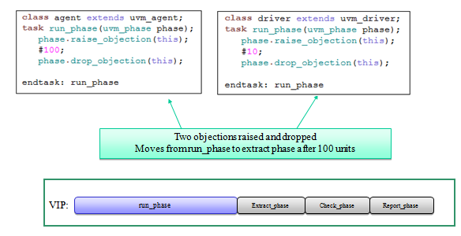
Objections Example

Slide 45
Messaging and Reporting mechanism
uvm_report_object class provides set of methods that can be used to report messages in order to facilitate debugging.
Severity of messages could be
Info
Warning
Error
Fatal
Notes:
UVM_INFO - UVM_DISPLAY
UVM_WARNING - UVM_DISPLAY
UVM_ERROR - UVM_DISPLAY | UVM_COUNT
UVM_FATAL - UVM_DISPLAY | UVM_EXIT

Slide 46
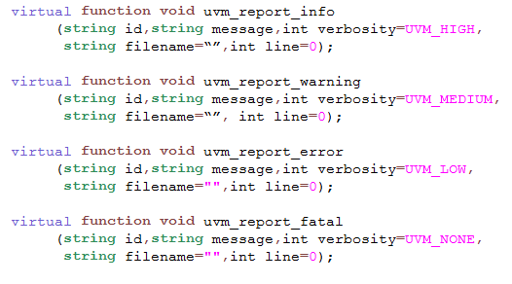
Reporting Methods
Use `_FILE_
`_LINE_ macros
for filename
and line
number
Not recommended
Notes:
Id- a unique id for the report or report group that can be used for identification and therefore targeted filtering. You can configure an individual report’s actions and output file(s) using this id string.
Message- the message body, preformatted if necessary to a single string.
Verbosity- the verbosity of the message, indicating its relative importance. If this number is less than or equal to the effective verbosity level, see set_report_verbosity_level, then the report is issued, subject to the configured action and file descriptor settings. Verbosity is ignored for warnings, errors, and fatals. However, if a warning, error or fatal is demoted to an info message using the uvm_report_catcher, then the verbosity is taken into account.
filename/line- (Optional) The location from which the report was issued. Use the predefined macros, `__FILE__ and `__LINE__. If specified, it is displayed in the output.

Slide 47
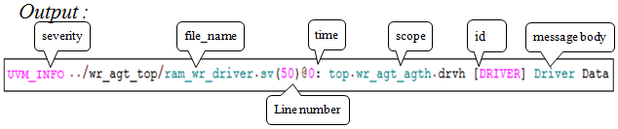
UVM Macros
Reporting macros
Recommended
`__FILE__ and `__LINE__ information is automatically displayed
Disable display of file and line information using UVM_REPORT_DISABLE_FILE_LINE on the command line
Verbosity - UVM_NONE for warnings, errors and fatals
`uvm_info (id, message, verbosity)
`uvm_warning (id, message)
`uvm_error (id, message)
`uvm_fatal (id, message)
Example:
Notes:
This set of macros provides wrappers around the uvm_report_* Reporting functions.

Slide 48
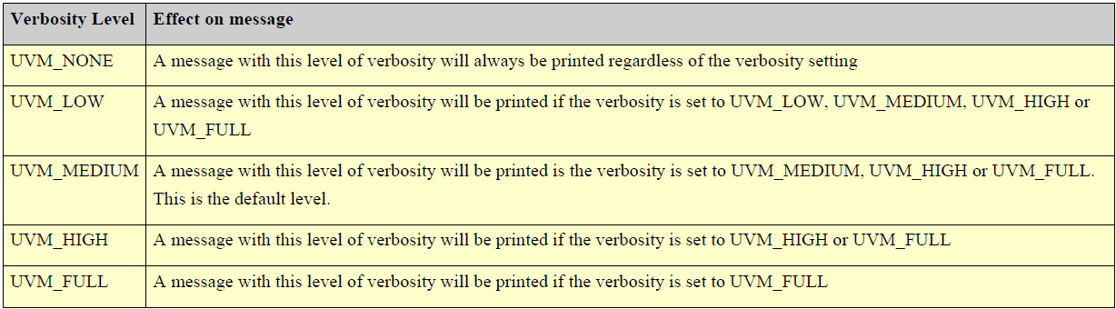
Verbosity Levels
Command-Line Arguments

Slide 49
Configuration database:
uvm_config_db is extended from uvm_resource_db
UVM provides Configuration Database class to set integers, strings, virtual interfaces, objects etc resources with hierarchal context
All functions in uvm_config_db #(type T) are static in nature and can be accessed with help of scope resolution operator(::)
We create configuration class for customizing and we can able to set that in config_db and we can able to get it with respect to the hierarchy
Generally set/get is done in the build phase
Notes:
uvm_config_db is used when you want to set/get resource within uvm component hierarchy.
uvm_resource_db is used when you want to set/get resource except uvm componet hierarchy.

Slide 50
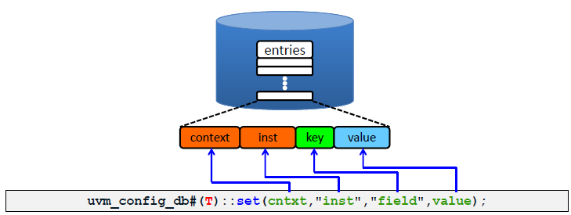
Configuration databases Methods:
To specify the type of field
Provides the complete scope
Place from which the setting will affect
Name of the field to be updated
Updated value for given field
Notes:
Default type of T is int
If cntxt=null means that we are setting at the top of all

Slide 51
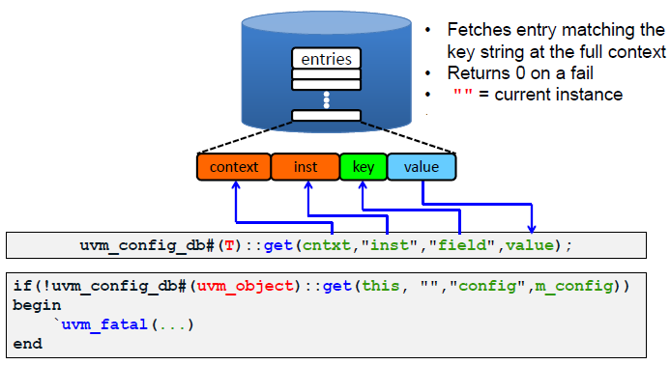
Configuration databases Methods:
Notes:
Default type of T is int
…::get(this,” “, ”field”, value);
“ ” -> actually access anything // use this always
“test1.env.agent2 ”=> Not advisable unless components are tightly coupled

Slide 52
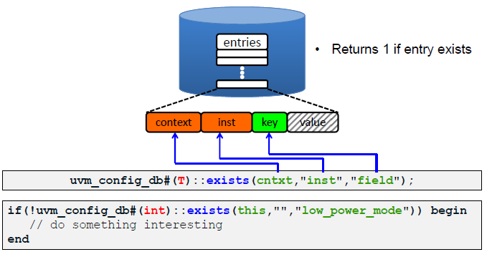
Configuration databases Methods:
Notes:
Default type of T is int

Slide 53
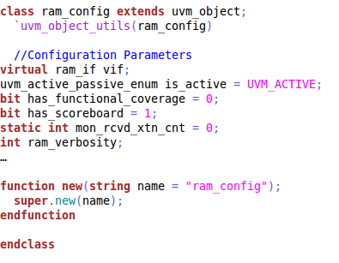
Configuration Object:
Extended from uvm_object

Slide 54
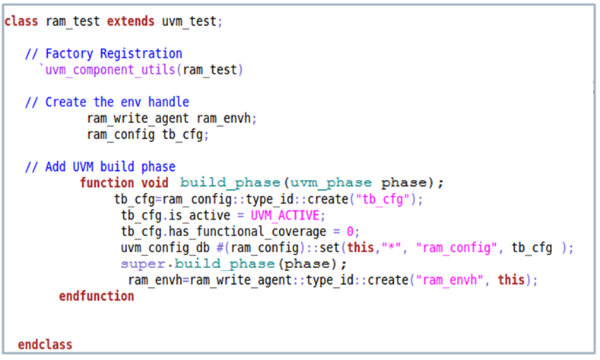
Set config object:
create config object
configure parameters
config database : set
ram_config = tb_cfg

Slide 55
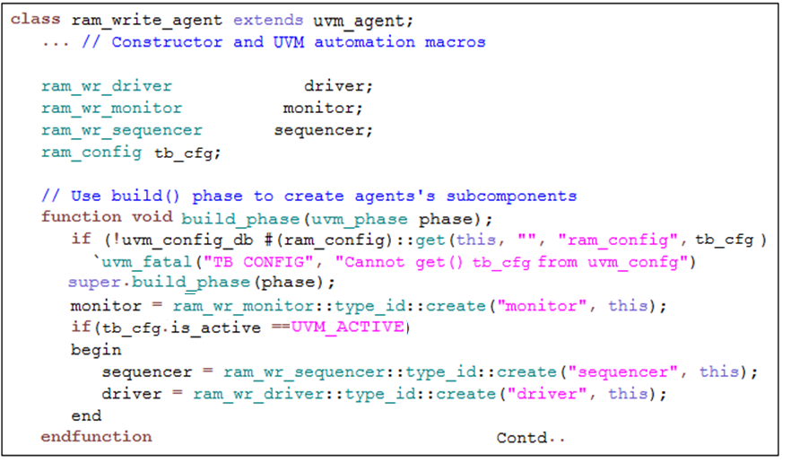
Get config object:
config object handle
config database :get
tb_cfg = ram_config
Use parameters

Slide 56




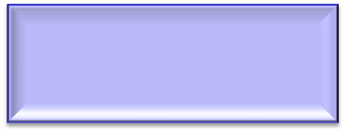






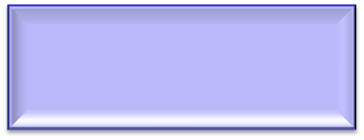




Uvm_config_db – set/get
Top
ram_test
SET “is_active” = 1
ram_env
agent[0]
agent[0]
GET “is_active”
database
agent[1]
*agent*
is_active = 1
agent[1]
GET “is_active”
agent[2]
agent[2]
GET “is_active”
agent[3]
agent[3]
GET “is_active”

Slide 57







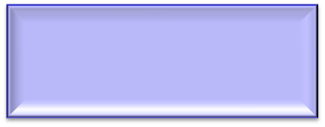


Uvm_config_db – set/get
Top
ram_test
SET is_active = 1
ram_tb
agent[0]
GET “is_active” Fails
Config db
*agent[2]*
is_active = 1
agent[1]
GET “is_active” Fails
agent[2]
agent[2]
wr_agent
GET “is_active” Pass
agent[3]
GET “is_active” Fails

Slide 58




Virtual IF-Configuration:
uvm_config_db
uvm_config_db #(virtual ram_if)::get(this, “”, "vif", vif)
uvm_config_db #( virtual ram_if )::set( null , “*" , “vif" , in0);
vif -> in0
Top Module
ram_test
ram_config
ram_tb
DUT
write_agent
S
D
Interface in0
M

Slide 59
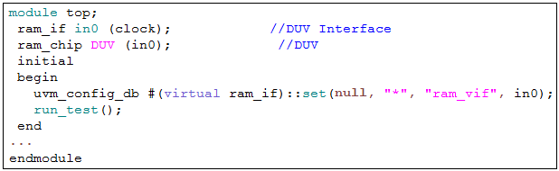
Virtual Interface – Top:
type : virtual ram_if
config database : set
ram_vif = in0

Slide 60
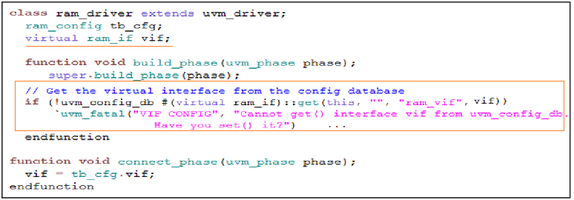
Virtual Interface – Driver:
type : virtual ram_if
config database : get
vif = ram_vif

Slide 61
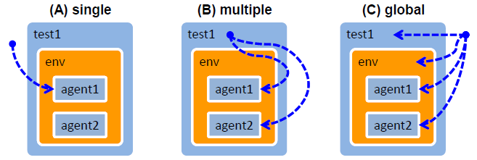
Hierarchical Access Examples:
(A) uvm_config_db#(T)::set(uvm_root::get(),"test1.env.agent1“, "config", m_config)
(B) uvm_config_db#(T)::set(this,"env.agent*","config", m_config)
(C) uvm_config_db#(T)::set(null,"*","global_cfg", m_global_cfg)

Slide 62
Building the testbench Components

Slide 63
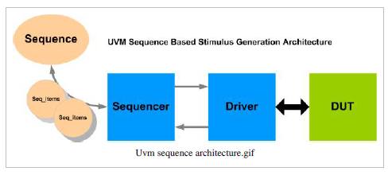

Slide 64
Building the Driver
What is driver?
Drives data items to the DUT following the interface protocol.
It gets data items from the sequencer for execution.
The UVM Class Library provides the uvm_driver base class from which all driver classes should be extended, either directly or indirectly.
The driver has a run() method that defines its operation, as well as a TLM port through which it communicates with the sequencer

Slide 65
How to Create a Driver?
Derive a driver from the uvm_driver base class.
Implement utilities for printing, copying, comparing, and so on.
Declare a virtual interface in the driver to connect the driver to the DUT.
Obtain the next data item from the sequencer and execute it (in run() method)
Implement the actual design interface protocol
https://www.edaplayground.com/x/3kMC

Slide 66
Sequencer
What is Sequencer ?
Sequencer is a component that passes stimulus data from a generator (Sequence) to a driver.
Multiple sequences can be trying to send sequence items to driver - Sequencer arbitrates between them
UVM base class: uvm_sequencer
uvm_sequencer base class contains all of the base functionality required to allow a sequence to communicate with a driver.
uvm_sequencer #(simple_item, simple_rsp) sequencer;
Parameterized with request and response
https://www.edaplayground.com/x/3kMC
Notes:
uvm_void=> uvm_object=> uvm_report_object=>uvm_component=>uvm_sequencer_base
=>uvm_sequencer_param_base#(REQ,RSP)=>uvm_sequencer#(REQ,RSP)
class uvm_sequencer #(
type REQ = uvm_sequence_item,
RSP = REQ
) extends uvm_sequencer_param_base #(REQ, RSP)

Slide 67
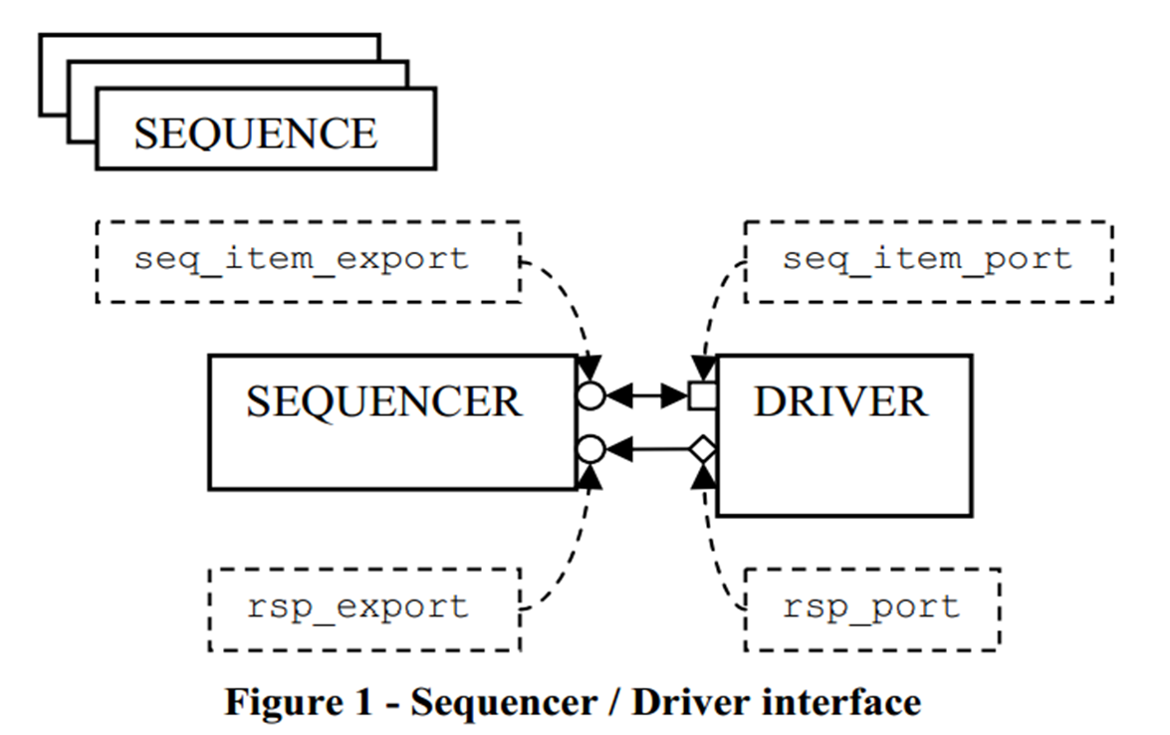
Sequencer – Driver Connection
Connected using TLM ports.
Driver pulls data from Sequencer using get_next_item()
Driver has a sequence_item_port that is connected to a sequence_item_export in the Sequencer

Slide 68
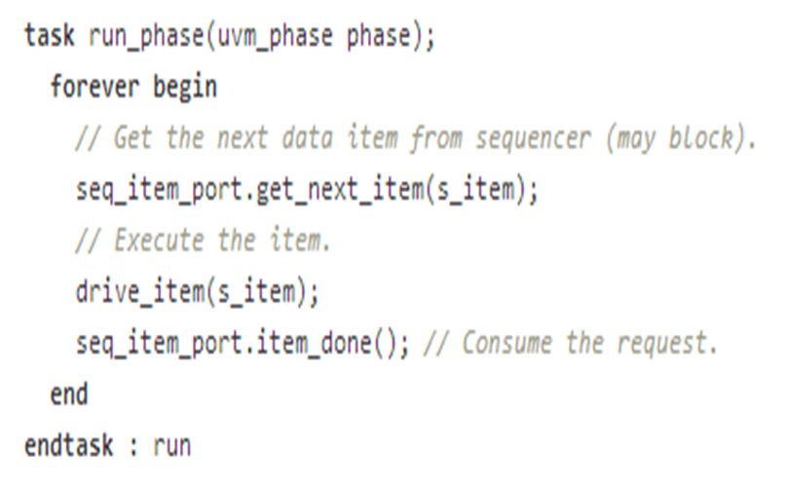
Connect Method – In Agent
function void connect_phase(uvm_phase phase);
driver.seq_item_port.connect(sequencer.seq_item_export);
endfunction
Run phase at the driver

Slide 69
UVM Monitor
What is Monitor?
Extracts signal level information and translates to objects/events or high level information
Passes this information to other Test bench components through TLM connections
Usually passes information to coverage collectors or scoreboards using analysis ports/exports

Slide 70
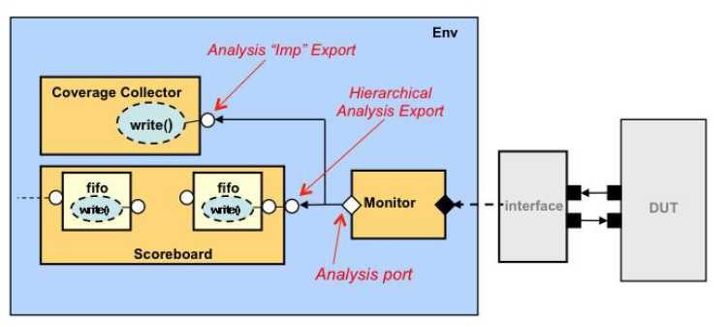
UVM Monitor

Slide 71
How to create a monitor?
Derive a monitor from the uvm_monitor base class.
Implement the logic to monitor signal level information (using a virtual interface)
Translate signal level information to transaction.
Implement an analysis port to which monitored transactions are to be written out
All other components that need this information in the test bench need to connect to this analysis port
https://www.edaplayground.com/x/694_

Slide 72
UVM Agent
What is an Agent ?
Collection of a group of uvm_components focused around a specific pin-level interface
Typically instantiates driver, sequencer, monitor and connects them all together
Also will have a configuration components
Multiple agents can be used for multiple DUT interfaces which has different protocol
Agents can be reused for similar interfaces
Components within an agent can be configured active/Passive
Active - Contains active components like driver, sequencer
Passive – Contains only passive components like monitors

Slide 73
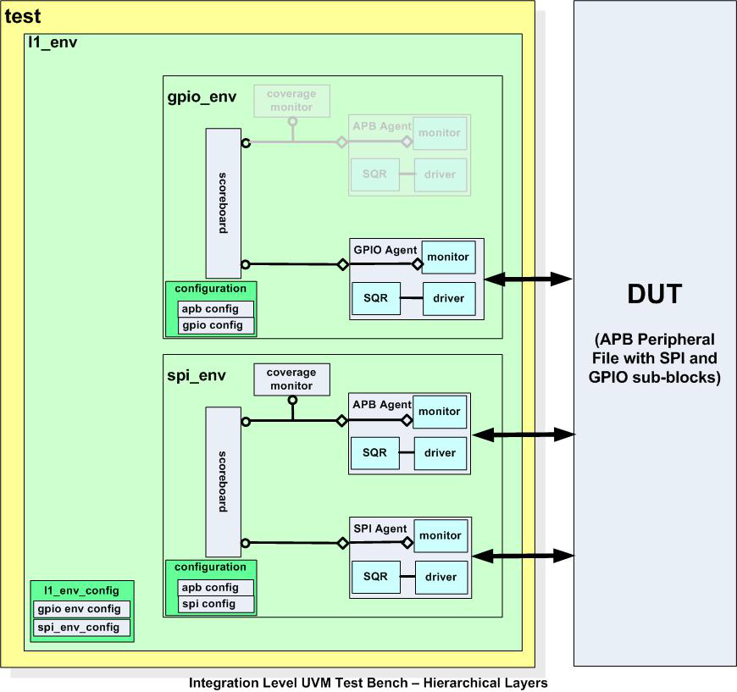
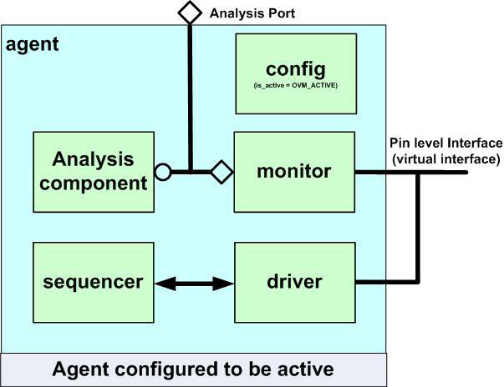
https://www.edaplayground.com/x/28Um

Slide 74
UVM Environment
Environment is the top level container class
All agents are instantiated and configured in env class
Most verification reuse happens at env level
A top level env can instantiate multiple block level environment class
Different projects can instantiate envs and configure for different agents etc
Collection of OVM/UVM Agents
Allows interface level reuse
Has its own configuration object
eg: can control no of agents, env.config can set agent.config
Can have analysis components like scoreboard, coverage, monitor
Multiple block level env classes can be instantiated to have top level env
https://www.edaplayground.com/x/5Ae7

Slide 75
UVM Test
Test is the top level class that instantiates ENV, configures the testbench and initiates construction
Individual tests derive from uvm_test
Each test case instantiates uvm_env and configures them
Test bench activated with a call to run_test() which starts build phases
https://www.edaplayground.com/x/65An

Slide 76

UVM Sequences
Sequence is derived from uvm_sequence and parameterized with sequence_item type
Two important properties
body() method
m_sequencer handle
Notes:
uvm_object=>uvm_transaction=> uvm_sequence_item => uvm_sequence

Slide 77
UVM sequence
body() method
The content of the body method that determines what the sequence does.
m_sequencer handle
The m_sequencer handle contains the reference to the sequencer on which the sequence is running.

Slide 78

Steps to run a sequence
Step 1 – Sequence Creation
Declare a Sequence and Create Sequence using factory
Using factory allows sequences to be overridden from tests

Slide 79
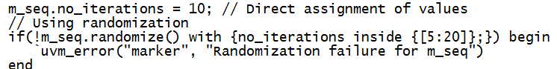
Steps to run a sequence
Step 2 – Sequence Configuration
Setting up start values - e.g. a start address or data value
Setting up generation loop variables - e.g. number of iterations, which index number to start from

Slide 80


Steps to run a sequence
Step 3 – Starting the Sequence
Started using start() method which is blocking and returns at end of executing body()
Arguments - sequencer type and 3 optional ones
Notes:
Calling one seq in another seq.: apb_compare_seq.start(m_sequencer);//this-optional
In test: seque.start(null)

Slide 81
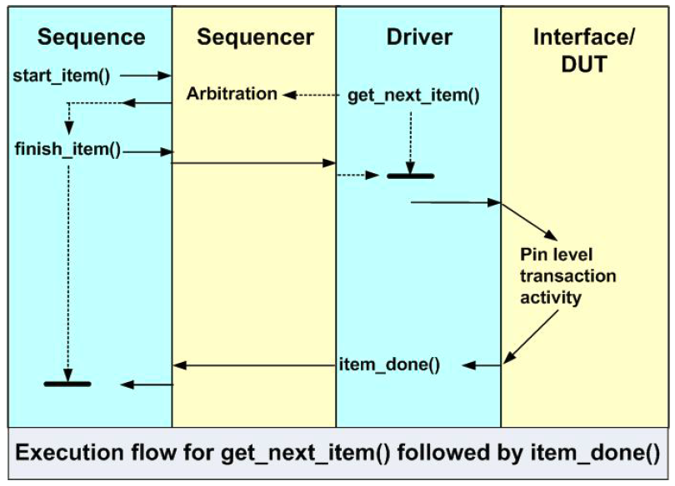
Sending Sequence Items to Driver
Create Sequence Item using factory
Call start_item()
Blocks until Sequencer grants access to Sequence
Set/Randomize
Set up sequence item properties or randomize
Call finish_item()
Blocks until driver completes its transfer
Call get_response() - optional
Blocks until a response is received from driver
Notes:
In body method we have to do the above
Start_item and finish_item are the methods of <uvm_sequence_base::start_item()>

Slide 82
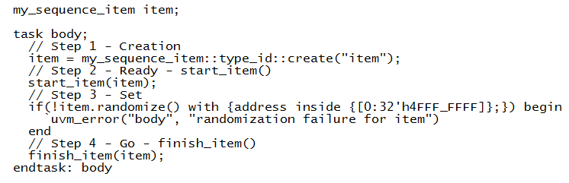
In Sequence body method:

Slide 83


Sequence Related Macros
`uvm_do
https://edaplayground.com/x/yw4

Slide 84
`uvm_do macro
Class simple_sequence extends uvm_sequence#(simple_trans);
`uvm_object_utils(simple_sequence)
//constructor
function new(string name= “simple_sequence”);
super.new(name);
endfunction
virtual task body();
`uvm_do(req)
endtask
endclass
`uvm_create and `uvm_send macro
Class simple_sequence extends uvm_sequence#(simple_trans);
`uvm_object_utils(simple_sequence)
//constructor
function new(string name= “simple_sequence”);
super.new(name);
endfunction
virtual task body();
`uvm_create(req)
assert(req.randomize());
`uvm_send(req)
endtask
endclass
Notes:
req-> default handle of the sequence_item or sequence

Slide 85
`uvm_rand_send macro
Class simple_sequence extends uvm_sequence#(simple_trans);
`uvm_object_utils(simple_sequence)
//constructor
function new(string name= “simple_sequence”);
super.new(name);
endfunction
virtual task body();
`uvm_ create(req)
`uvm_rand_send(req)
endtask
endclass
`uvm_do_with macro
Class simple_sequence extends uvm_sequence#(simple_trans);
`uvm_object_utils(simple_sequence)
//constructor
function new(string name= “simple_sequence”);
super.new(name);
endfunction
virtual task body();
`uvm_do_with(req,{wr_en == 1;})
endtask
endclass

Slide 86
`uvm_do_pri macro
Class simple_sequence extends uvm_sequence#(simple_trans);
`uvm_object_utils(simple_sequence)
//constructor
function new(string name= “simple_sequence”);
super.new(name);
endfunction
virtual task body();
`uvm_do_pri(req, 9)
endtask
endclass
`uvm_do_pri_with macro
Class simple_sequence extends uvm_sequence#(simple_trans);
`uvm_object_utils(simple_sequence)
//constructor
function new(string name= “simple_sequence”);
super.new(name);
endfunction
virtual task body();
`uvm_do_pri_with(req, 5 , { addr inside {[1:40]};})
endtask
endclass

Slide 87
`uvm_rand_send_with macro
Class simple_sequence extends uvm_sequence#(simple_trans);
`uvm_object_utils(simple_sequence)
//constructor
function new(string name= “simple_sequence”);
super.new(name);
endfunction
virtual task body();
`uvm_ create(req)
`uvm_rand_send_with(req, {rd_en == 1})
endtask
endclass
Notes:
`uvm_create_on, `uvm_do_on, `uvm_do_on_pri, `uvm_do_on_with, `uvm_do_on_pri_with=>These macros are used to start sequences and sequence items on a specific sequencer.(`uvm_create_on(SEQ_OR_ITEM, SEQR))

Slide 88


Starting Sequence inside sequence
Notes:
SystemVerilog Advanced Verification Using OVM v8.2
SystemVerilog Advanced Verification Using OVM v8.2
In test: run_phase
ram_main_seq.start(null);

Slide 89
Sequencer – Driver connection
function void connect_phase(uvm_phase phase);
driver.seq_item_port.connect(sequencer.seq_item_export);
driver.rsp_port.connect(sequencer.rsp_export);
endfunction

Slide 90
get_next_item()
Blocking method that waits until a sequence item (REQ) is available in sequencer FIFO and returns pointer of REQ
try_next_item()
Non-blocking variant of get_next_item
Returns NULL if no item available
item_done()
Indicates to the sequencer that the driver has processed the item and clears the item from the sequencer FIFO
Optionally sends response

Slide 91
peek()
Similar to get_next_item and blocks until a REQ is available
However doesn't remove the item from Sequencer FIFO. A subsequence item_done() will remove
get()
Similar to get_next_item and blocks until a REQ is available
However handshake is completed immediately and there is no need of calling item_done
put()
Non-blocking method used to place a response in Sequencer’s response FIFO
Unlike item_done(RESP) – put can be called any time independent of hand shake

Slide 92


Slide 93
UVM Sequence arbitration
There are total 6 arbitration mechanism
UVM_SEQ_ARB_FIFO
UVM_SEQ_ARB_WEIGHTED
UVM_SEQ_ARB_RANDOM
UVM_SEQ_ARB_STRICT_FIFO
UVM_SEQ_ARB_STRICT_RANDOM
UVM_SEQ_ARB_USER
The arbitration mechanism can be set using the function set_arbitration()
Syntax: m_sequencer.set_arbitration(UVM_SEQ_ARB_FIFO);
The user defined arbitration can be defined by overriding a method called user_priority_arbitration().
Notes:
By default , the arbitration algorithms is set to SEQ_ARB_FIFO//m_sequencer.set_arbitration(UVM_SEQ_ARB_FIFO);=> this is done in test or sequence
UVM_SEQ_ARB_WEIGHTED=> highest priority sequence are always picked first, If two sequences have equal priority, then the items from them are picked in a random order
UVM_SEQ_ARB_STRICT_FIFO=> similar to SEQ_ARB_WEIGHTED except that if two sequences have same priority, then the items from those sequences are picked in a FIFO order
UVM_SEQ_ARB_STRICT_RANDOM=> similar to SEQ_ARB_RANDOM except that the priorities are NOT ignored, picked randomly from sequences with highest priority first followed by next
virtual function integer user_priority_arbitration(integer avail_sequences[$]);// inside sequencer

Slide 94
Lock and grab of sequencer in UVM
Lock() 1) A lock() request is put in back of the arbitration queue . A lock request will be arbitrated the same as any other request. 2) A lock is granted after all earlier requests are completed and no other locks or grabs are blocking this sequence. 3) A lock() is blocking task and when access is granted, it will unblock. 4) If no argument is supplied, then current default sequencer is chosen.
Unlock() The unlock sequencer function is called from within a sequence to give up its lock or grab.

Slide 95
Lock and grab of sequencer in UVM
Grab() 1) A grab() request is put in front of the arbitration queue. A grab() request will be arbitrated before any other requests. 2) A grab() is granted when no other grabs or locks are blocking this sequence. (The only thing that stops a sequence from grabbing a sequencer is a pre-existing lock() or grab() condition.) 3) A grab() is blocking task 4) If no argument is supplied, then current default sequencer is chosen.
Ungrab() An alias of function unlock().
https://www.edaplayground.com/x/3w59

Slide 96
class simple_seq extends uvm_sequence #(seq_item);
seq_item req;
`uvm_object_utils(simple_seq)
function new(string name= “simple_seq”);
super.new(name);
endfunction
virtual task body();
lock();
`uvm_do(req)
unlock();
endtask
endclass
https://edaplayground.com/x/3w59

Slide 97
Add a Slide Title - 1

